Slide 1

Library Management System
Coded in Python by Tobi

Slide 2
Concept and Idea
The main concept was to create a simple library management system
One that allowed a librarian to search for books by title to check for its availability
Checkout available books
Return books that they had previously checked out
Showed the popularity of books. So that they could purchase more of a book depending on popularity.
The system also needed to be secure and only provide access to librarians that were registered on the system with a user ID and Password

Slide 3
Functions
Logging in system
Adding in users
Log into the system
Checking out books
Check out only books that were available and “In Stock”
Add check out of book to a log file
Returning books
Return books, for a specific user
Add return to a log file
Showed the popularity of a book
Using the data collected in the log file, create a graph showing the books that were checked out the most frequently.
Search for books in the database
Using a keyword search functionality

Slide 4
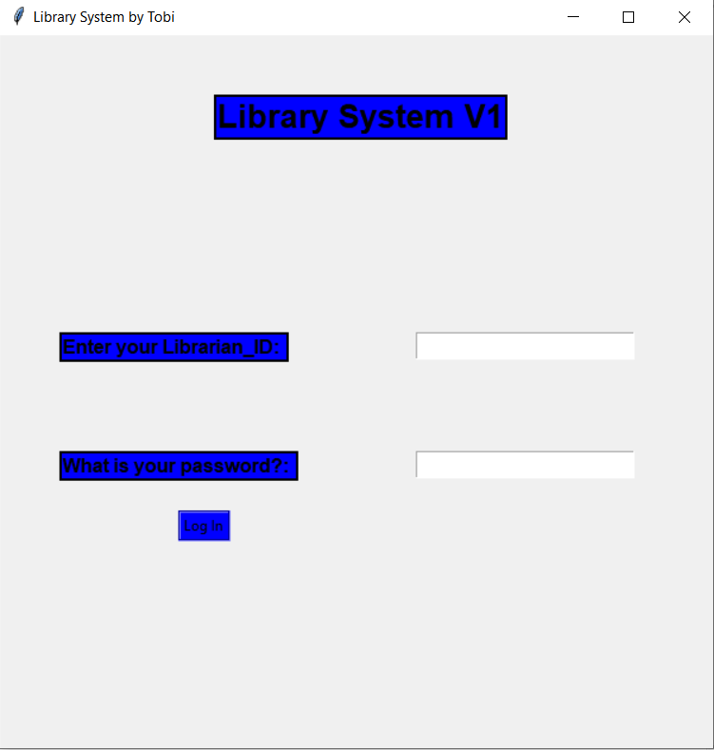
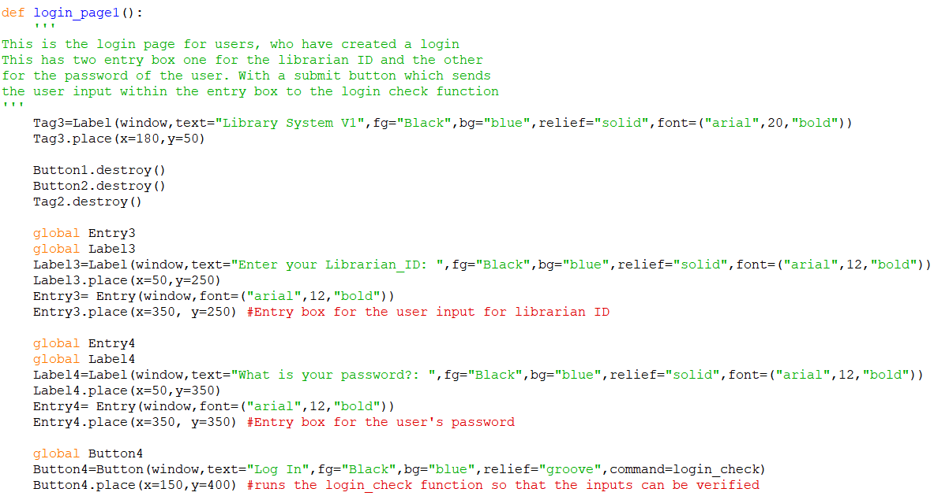
Main login page GUI

Slide 5
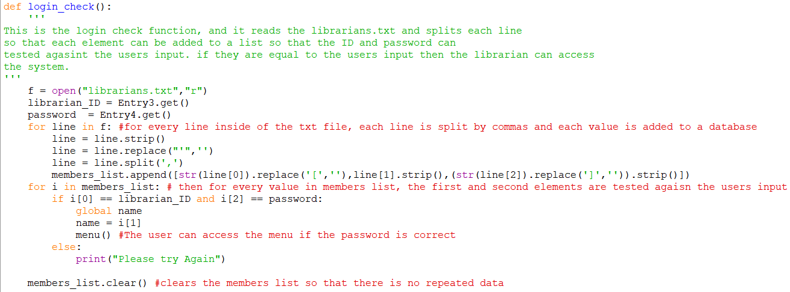
Login check

Slide 6
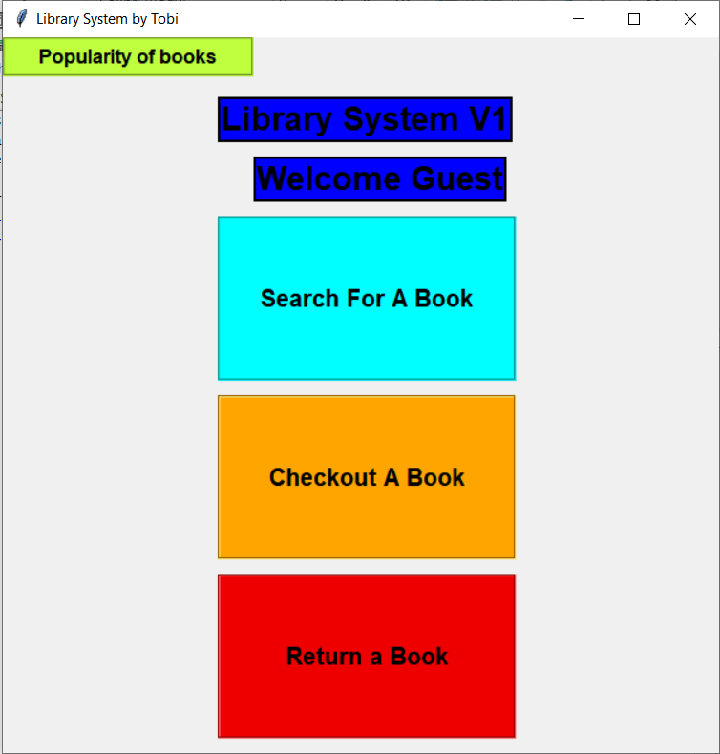
Menu
The menu is the main file of the system, it provides the GUI for the system – coded using the Tkinter module.
The menu file, also has the login functionality. This uses a text file, called librarian.txt, which stores all the librarian staff data, such as name, user ID and password. A new User_ID is randomly generated every time a new user is created. So when first running the program, it opens up a log in screen.
After logging in the user is introduced to the menu screen, the menu screen allows the user to access
The book popularity screen
The checkout book screen
The Return book screen
The search for a book screen
Notes:
This was the first time I had used Tkinter
We were originally taught only how to create new screens using tkinter, so in order to minimise the opening of screens, I created a reset screen function to the clear the original screen, so that it could be reused.

Slide 7
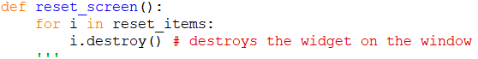
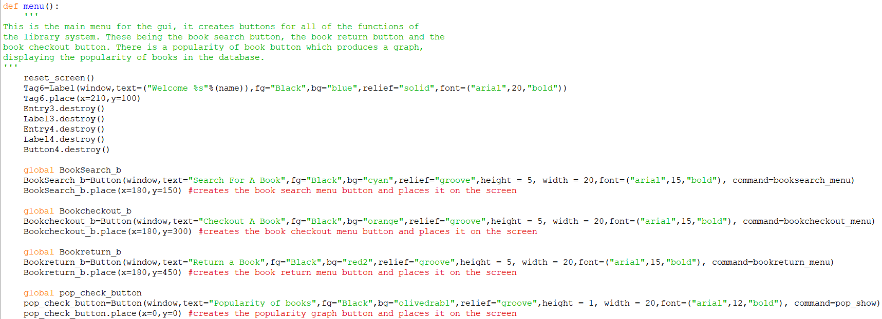
Menu code

Slide 8
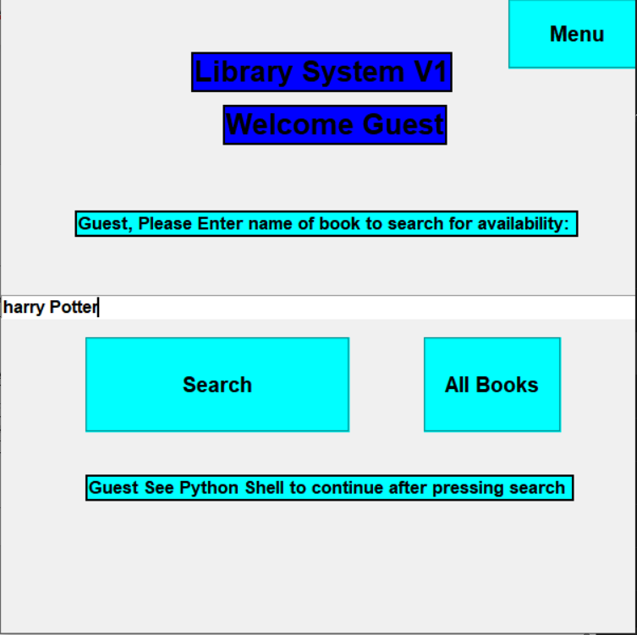
Book availability check
This allows the user to search for the title of a book and see if the library has any copies of the book in the first place.
Then tells the user whether or not the book is in stock or not.
This is done by taking all the books from the database.txt file, and saving them to an array called books. It then takes in a request from the user.
Splitting the request into words, so that they can be used as keywords. For each book in the array of books, a count is created to calculate which books have the most keywords from the request in them.
This produces a response in the cmd prompt.
The user will then confirm whether it is the book they are looking for, if not the second highest count will be suggested and so on.

Slide 9
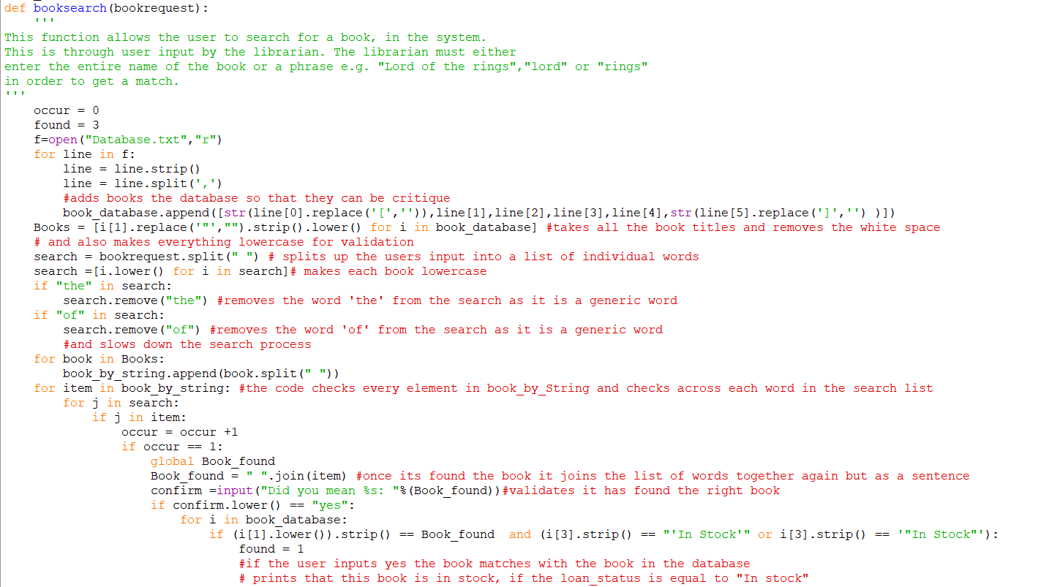
Book search Code Part 1

Slide 10
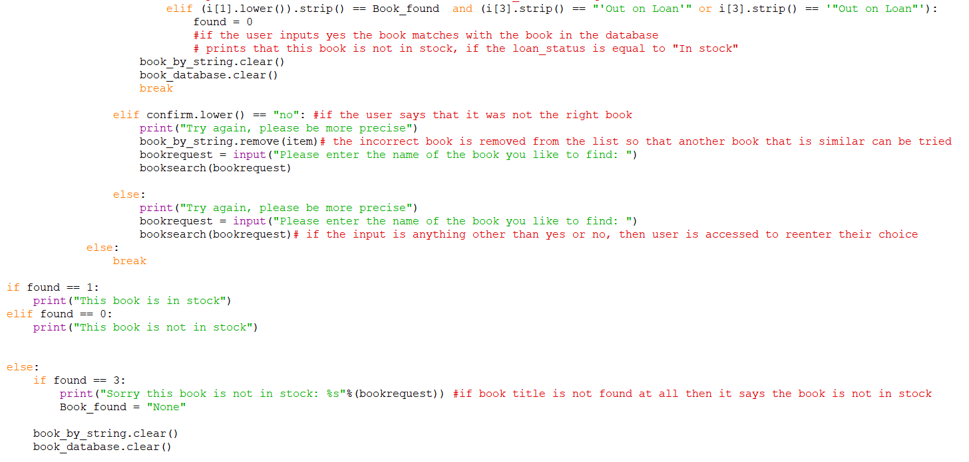
Book search Code Part 2

Slide 11
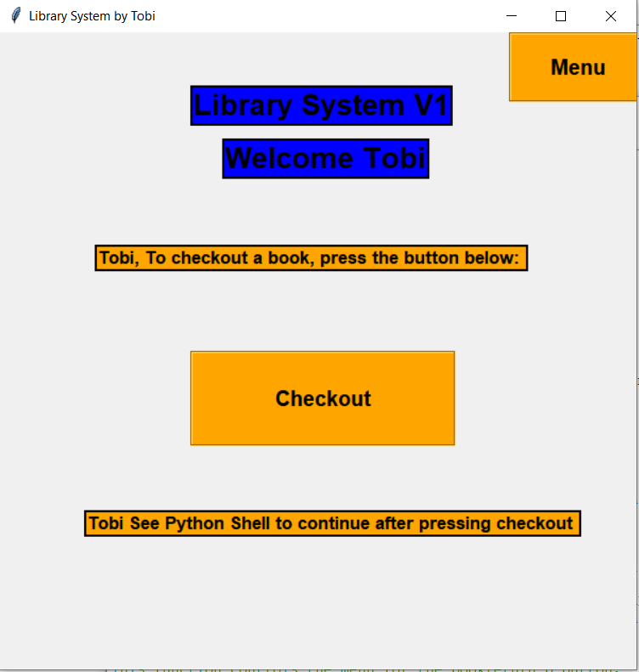
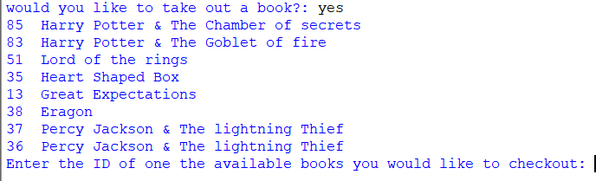
Checking out books
This allows the user to check out a book by ID, When the checkout book button has been pressed on the menu screen.
Then the user is given a list of available to checkout books.
The user then enters the ID of the book they would like to check out, followed by the ID of the customer and the system, changes the status of the book from “In stock” to “Out on loan” and assigns the customer ID to the book that has been taken out.
This is also added the log file.

Slide 12
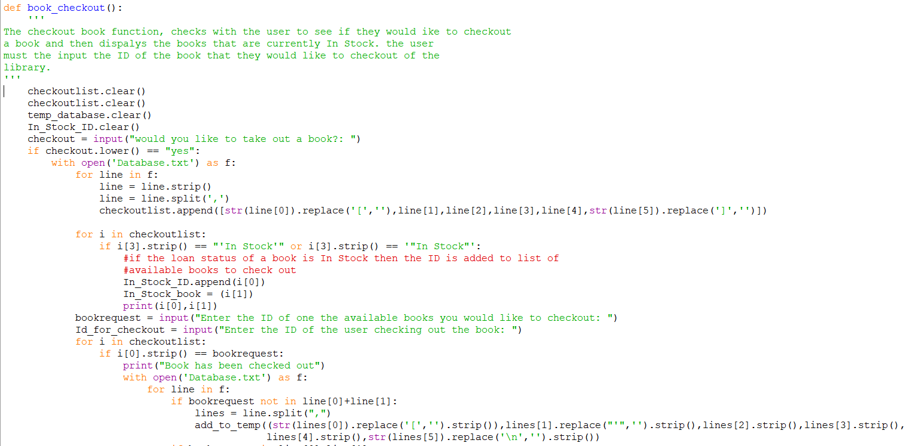
Book checkout code part 1

Slide 13
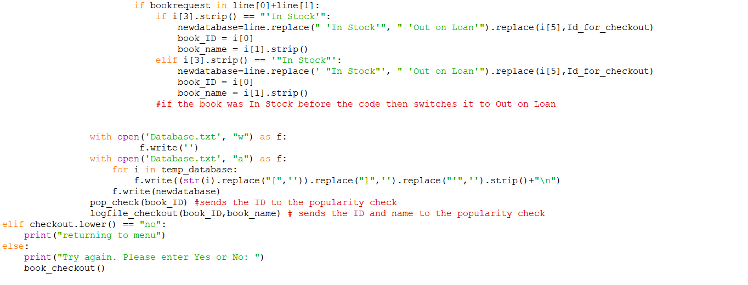
Book checkout code part 2

Slide 14
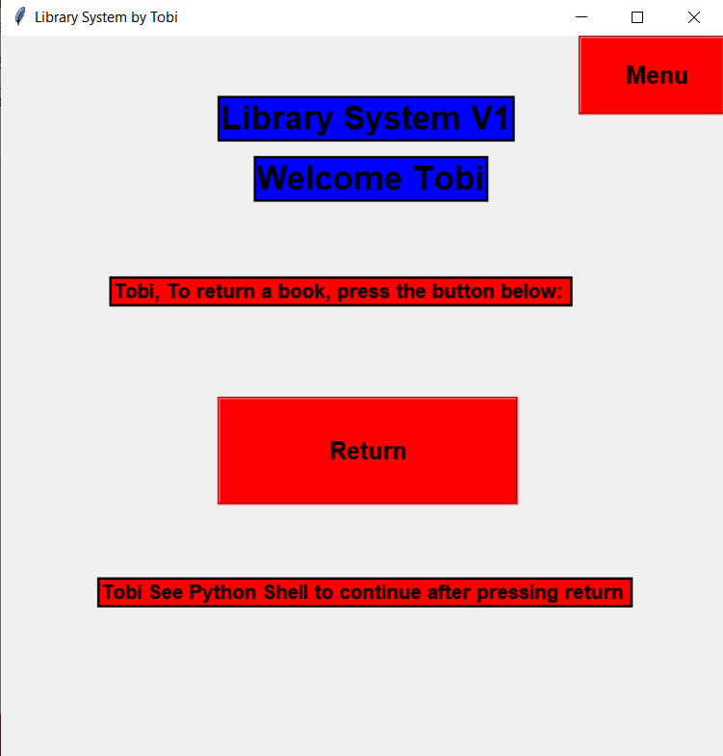
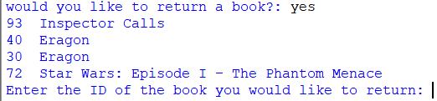
Returning books
This allows the user to return a book by ID. Firstly the return book button is pressed on the menu screen.
Then the user is given a list of books that need to be returned.
The user then enters the ID of the book they would like to return, and the system, changes the status of the book from “out of stock” to “In Stock” and assigns the customer ID to the book that has been taken out.
This is also added the log file.

Slide 15
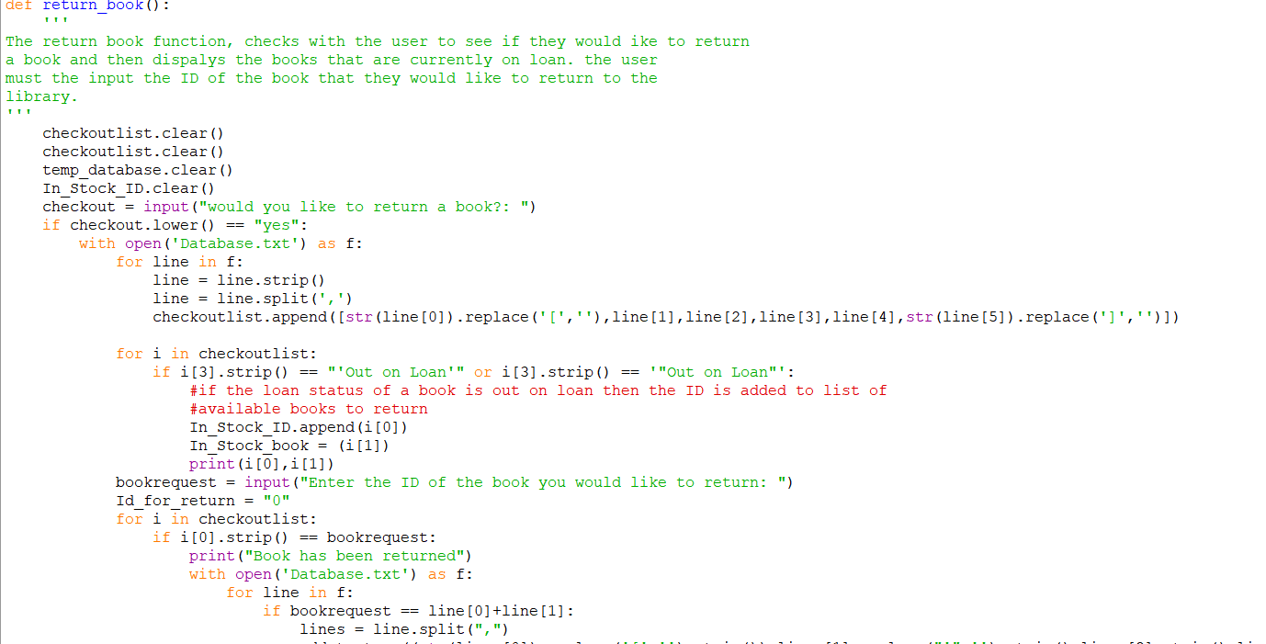
Return a book code part 1

Slide 16
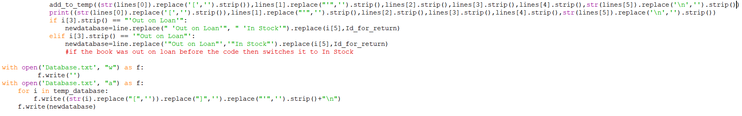
Return a book code part 2

Slide 17
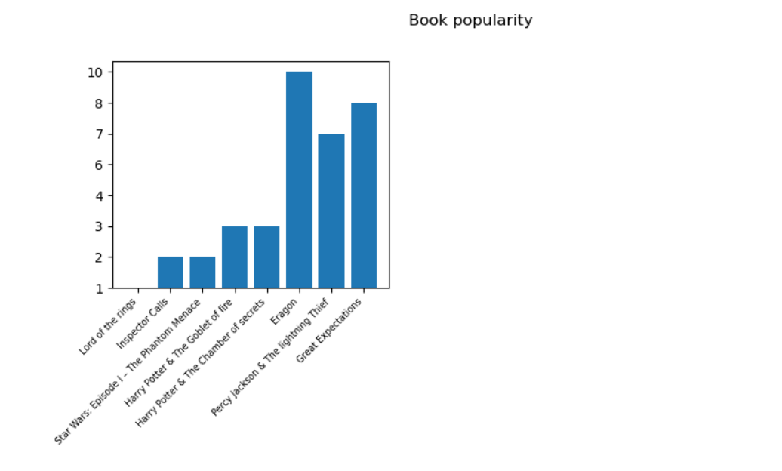
Popularity checker
When the popularity button is pressed on the menu screen.
A graphical representation of the most popular book is shown.
This is created by collecting all the transaction data on the books, such as returns and check outs and counting the number of times a book has been checked out.

Slide 18
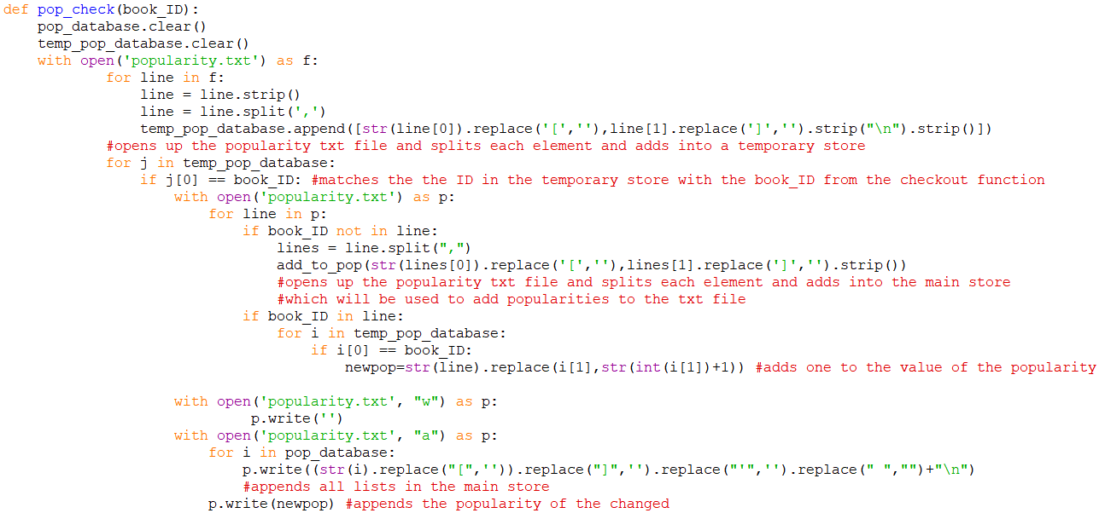
Popularity updater code

Slide 19
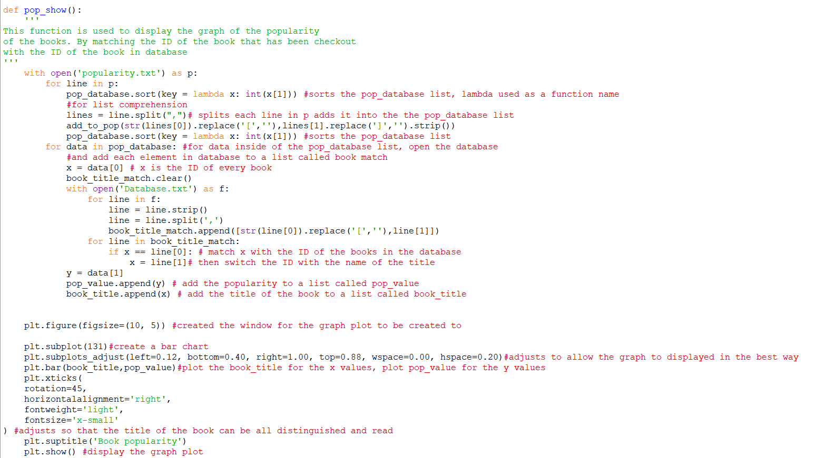
Popularity show code

